Slide 1
Project Analysis demo.opencart.com

Slide 2

Bio
Pushkar Ramesh Desai
160960
pushkardesai@outlook.com

Slide 3
Project analysis slide 2
Project Analysis
Opencart web application is an e-commerce website for electronic components and gadgets
It is using PHP as a backend and JavaScript for dynamic behaviour
Some of the functionalities provided by this app are :
Register
Login
Search products
Sort products
View product details
Add product to Wishlist
Add product to cart
User account management

Slide 4
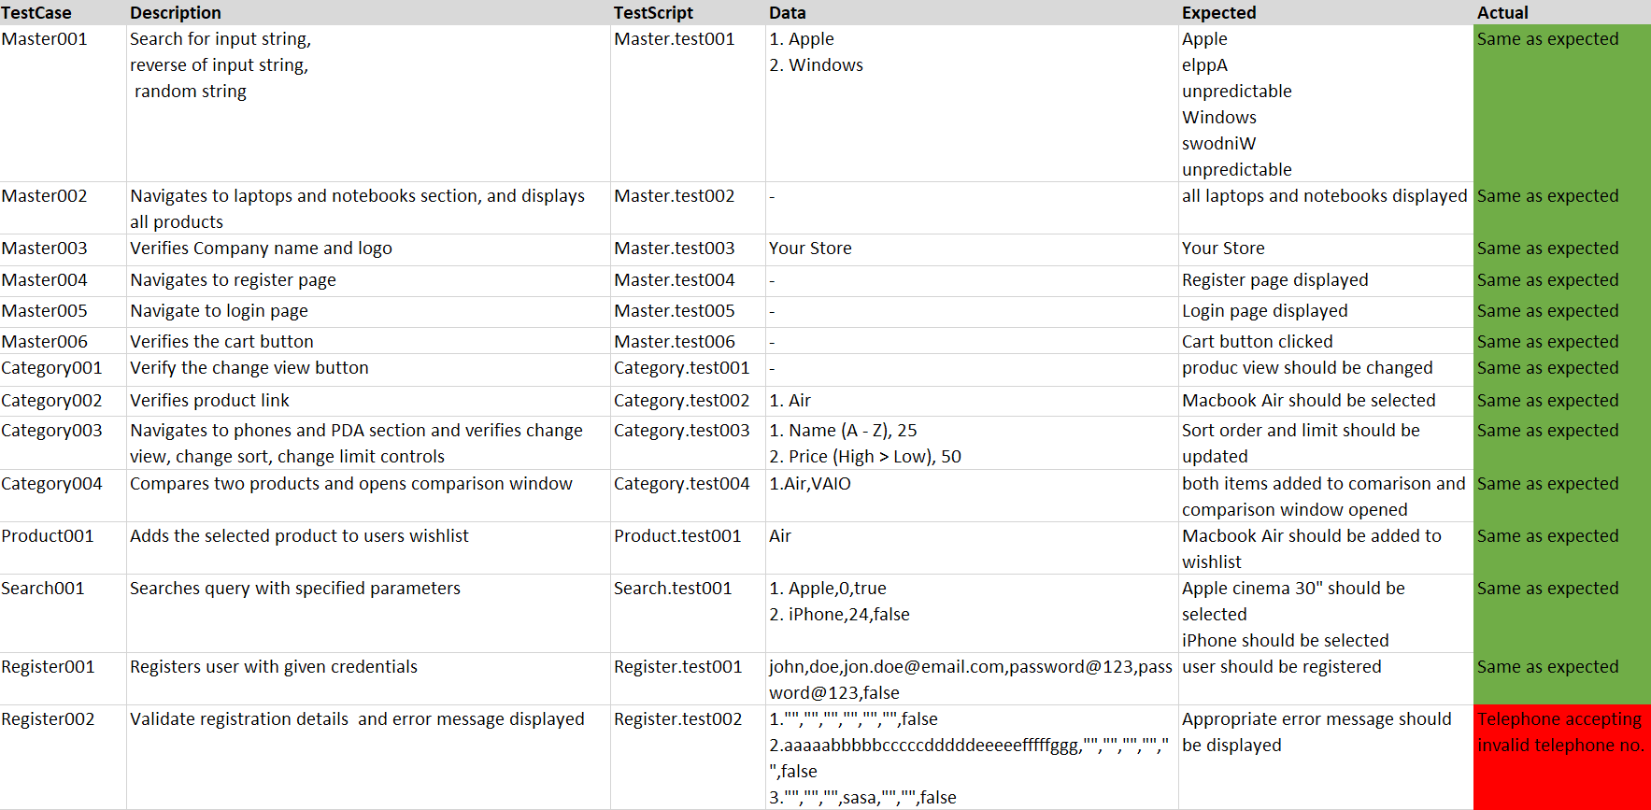
Project analysis slide 3
Project Analysis

Slide 5
Project Analysis

Slide 6
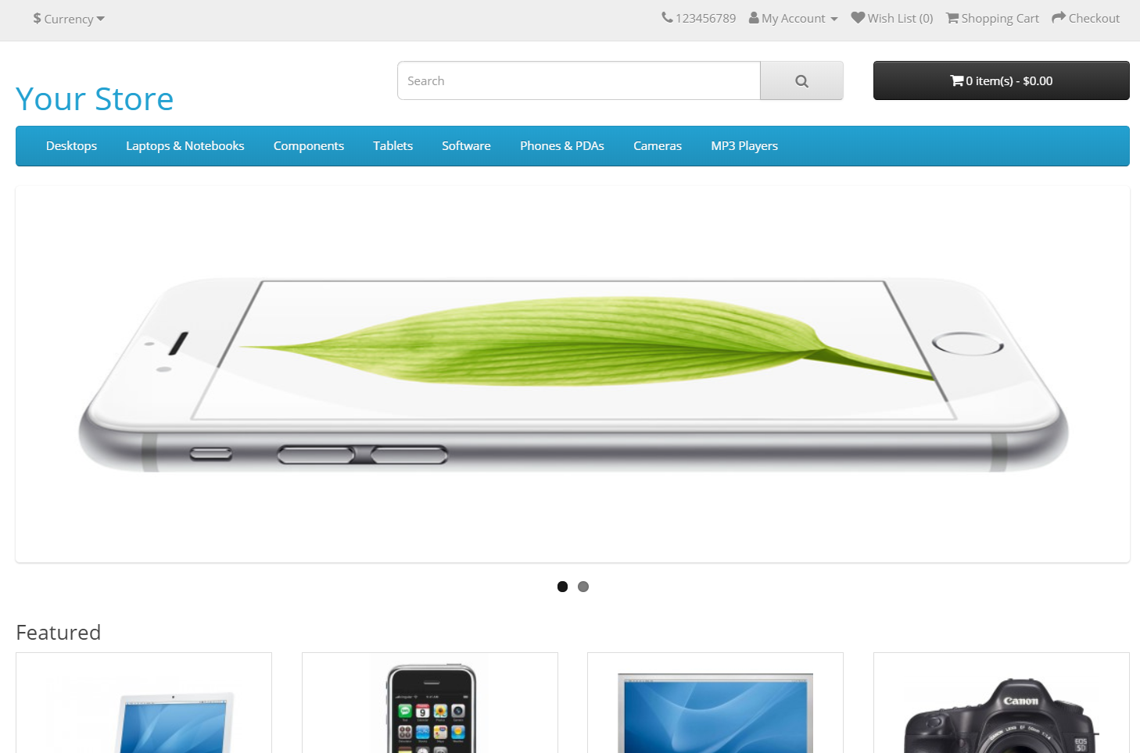

Slide 7
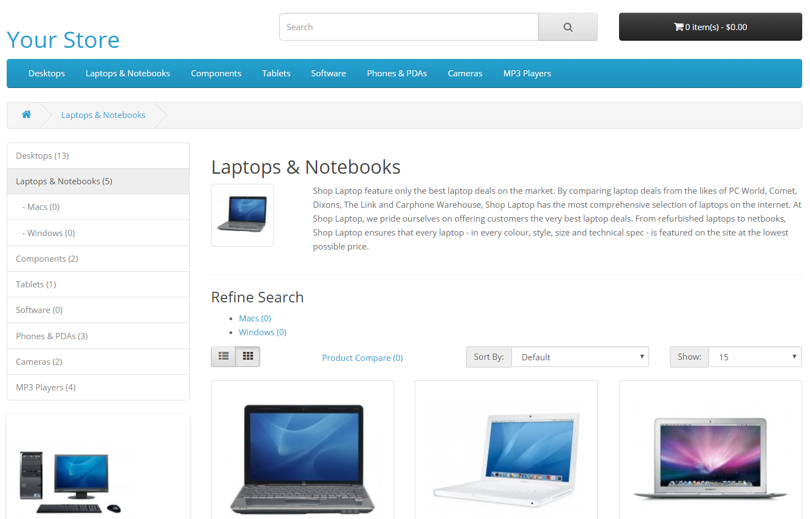

Slide 8
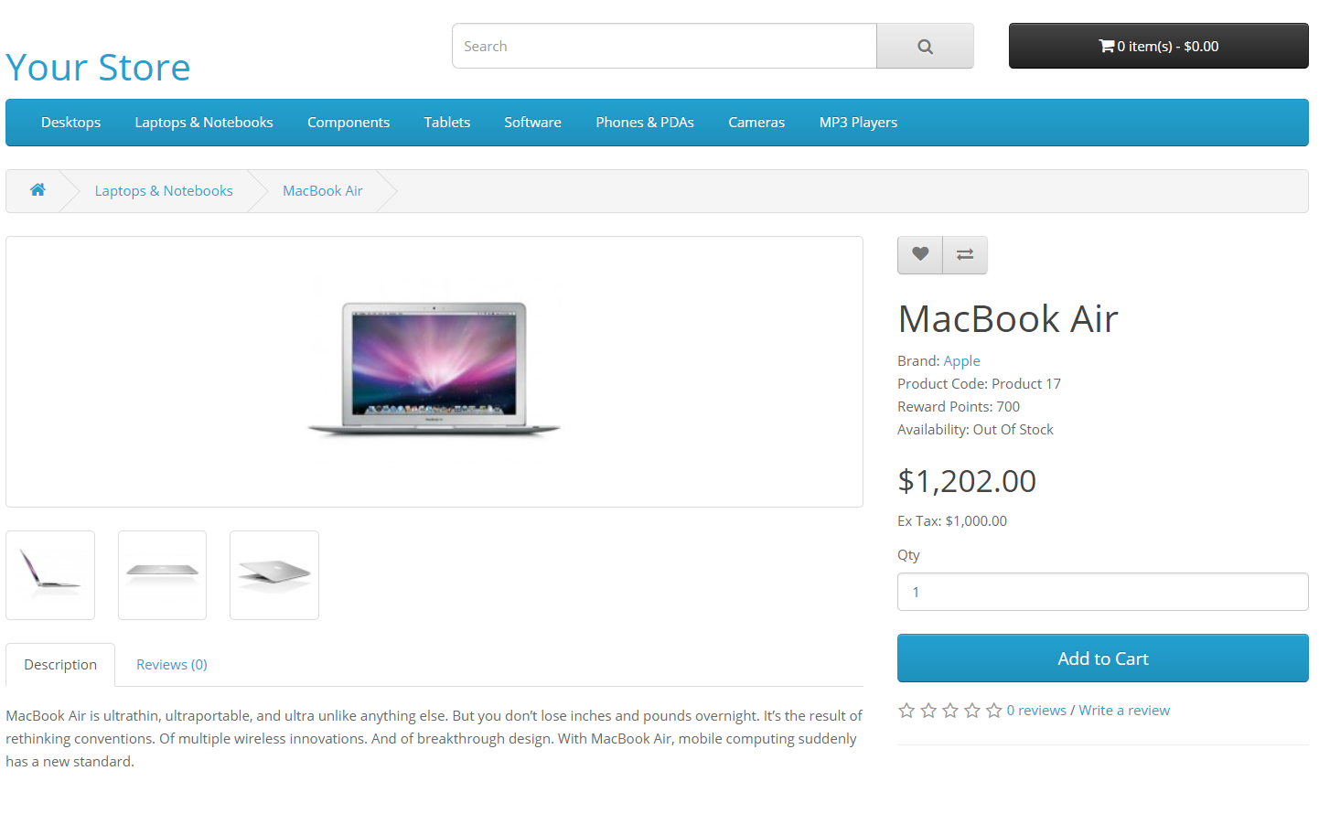

Slide 9
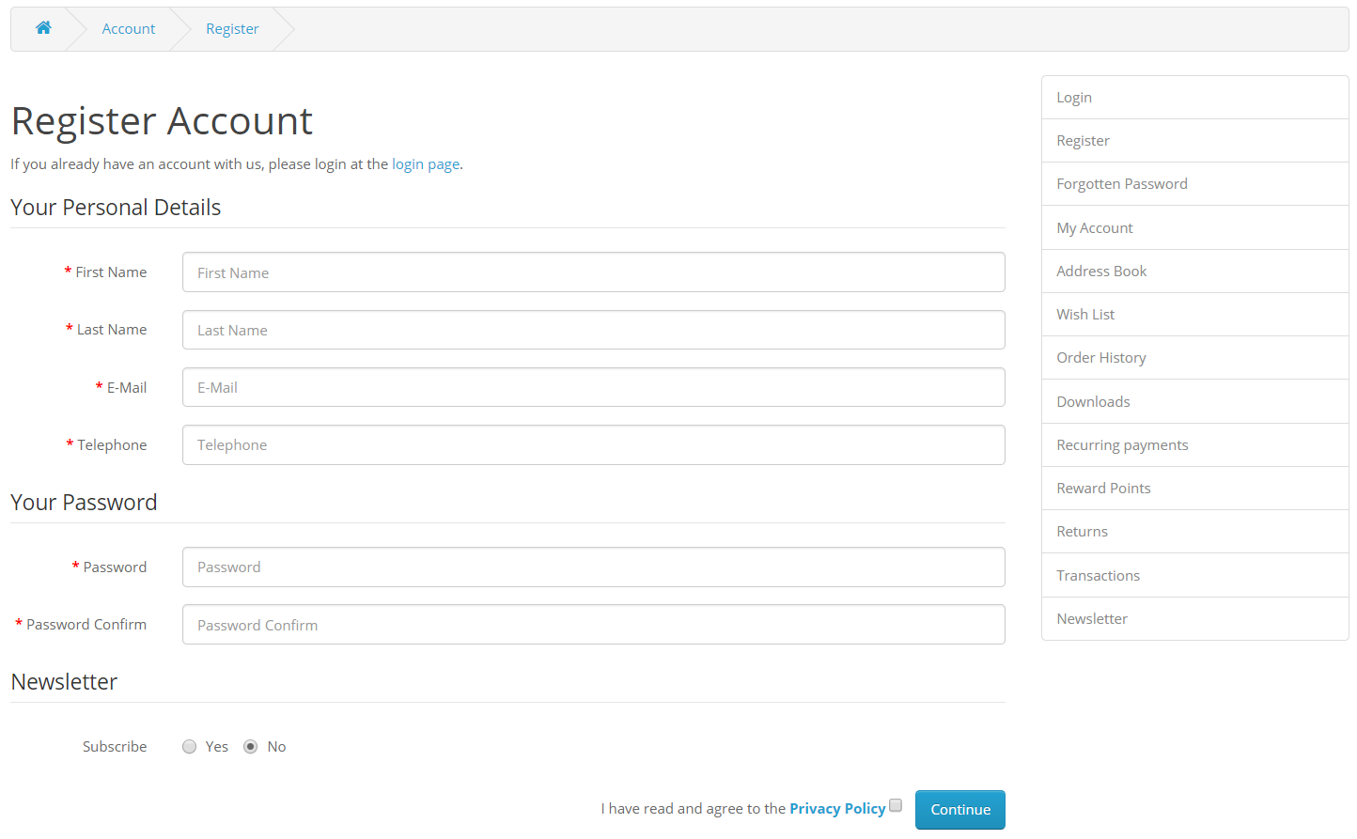

Slide 10
Thank You

